Slide 1
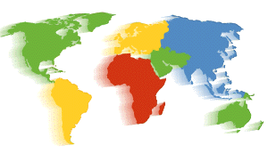
Biomes of the World
Match the animal to it’s home.
Click on the shape next to the biome.
next

Slide 2
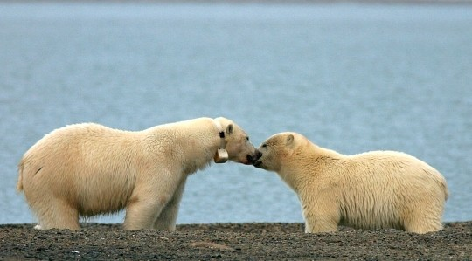
Where would you find a polar bear?
Tropical Rainforest
Desert
Tundra
Taiga
Temperate Forest
Grasslands
Notes:
A polar bears white coat helps it blend into it’s surroundings. Polar bears are very fast runners, and swimmers.

Slide 3
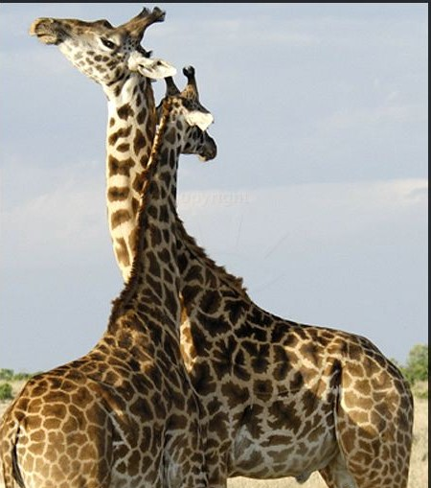
Where would you find giraffes?
Tropical Rainforest
Desert
Tundra
Taiga
Temperate Forest
Grasslands
Notes:
Giraffes are the tallest of all living land animals. They reach heights of 19 feet. A giraffe’s neck is 6 feet long, however they have the same number of bones in their neck as a human (7).

Slide 4
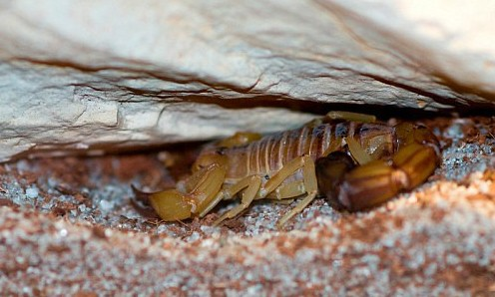
Where would you find a scorpion?
Tropical Rainforest
Desert
Tundra
Taiga
Temperate Forest
Grasslands
Notes:
Scorpions are in the same family as spiders. They are both arachnids.

Slide 5
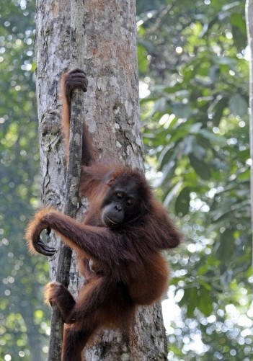
Where would find an orangutan?
Tropical Rainforest
Desert
Tundra
Taiga
Temperate Forest
Grasslands
Notes:
Orangutans are endangered. There are about 30,000 orangutans left in the wild.

Slide 6
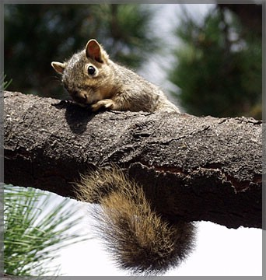
Where would you find a squirrel?
Tropical Rainforest
Desert
Tundra
Taiga
Temperate Forest
Grasslands
Notes:
There are over 300 different varieties of squirrels.

Slide 7
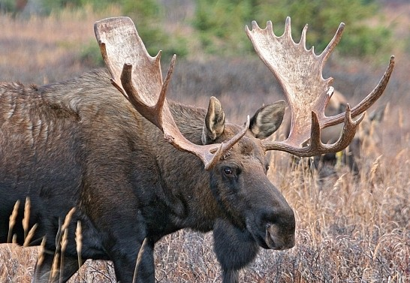
Where would you find a moose?
Tropical Rainforest
Desert
Tundra
Taiga
Temperate Forest
Grasslands
Notes:
Moose are native to North America, Europe, and Asia.

Slide 8
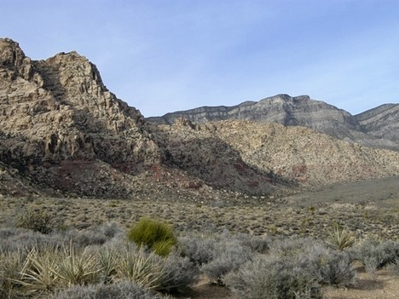
The Desert
Deserts are very hot, and very dry. Temperatures can drop at night as low as 40 degrees. It rarely rains in the desert.
Back

Slide 9
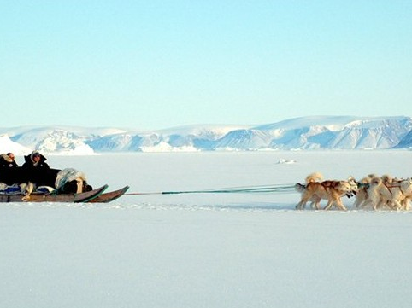
The Tundra
The tundra is found at the top of the world around the North Pole. It is snowy and cold in the Tundra.
Back

Slide 10
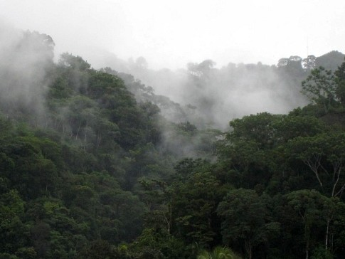
Tropical Rainforest
The tropical Rainforest is found close to the equator. It is very warm, and wet in the tropical rainforest.
Back

Slide 11
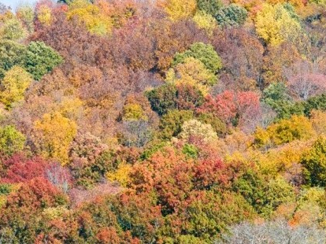
Temperate Forest
The temperate forest has 4 season, winter, spring, summer and fall. Animals and plants has special adaptations to cope with these yearly changes.
Back

Slide 12
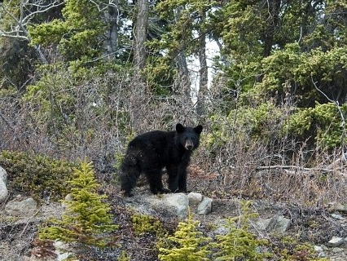
The Taiga
The taiga is the largest biome in the world. Winters are cold and summers are warm. There are many evergreen trees in the taiga.
Back

Slide 13
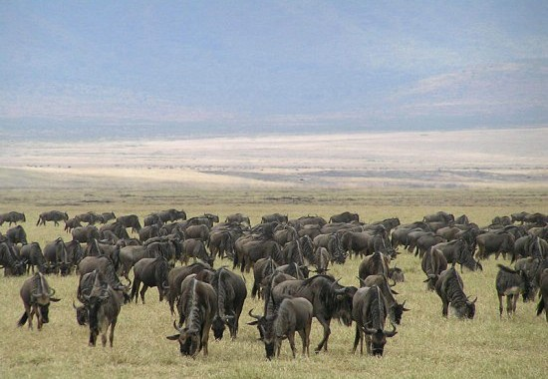
Grasslands
The grasslands are found on every continent except for Antarctica. In North America we call our grasslands prairies. In South America it is called savannas. I
Back

